Slide 1
Master thesis defense: Kidney Graft Loss Prediction Leveraging Multimodal Health Records
24.10.2022
Jan Frick

Slide 2
Agenda
Medical Problem
Solution: Machine Learning
Data and its challenges
Methodology
Evaluation
Discussion
Conclusion

Slide 3
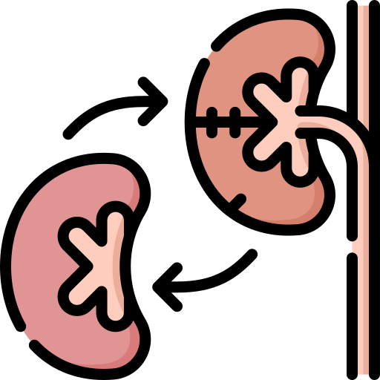
Medical Problem Identifying Patients with a high risk of kidney graft loss
High
Get checked
Risk of Graft Loss
Low
Patient with bad or no kidney function
Kidney transplant as treatment
Classification Problem
Stay Home ☺
Notes:
Delay or prevent Kidney Graft Loss
Gain knowledge for further research

Slide 4
Solution: Machine Learning Predicting kidney graft loss using supervised learning
Train Models for 2 Tasks
Short Term Prediction
Long Term Prediction
Continues the work on TBox:
Haldar 2020: Artificial Neural Network for the prediction of short-term graft failure of transplanted kidneys
Hienen 2021: Clustering-based prediction of long-term renal transplant failure risks
Reuter 2021: Prediction of Permanent Kidney Graft Loss via Deep Ensemble Learning and NLP using a biased Dataset of Electronic Health Records
Islam 2021: A Multi-Modal Deep Learning Strategy For Long Term Kidney Graft Loss Prediction On Imbalanced Dataset.
Notes:
Tbase a EHR for Kidney Transplant recipients
TaSK

Slide 5
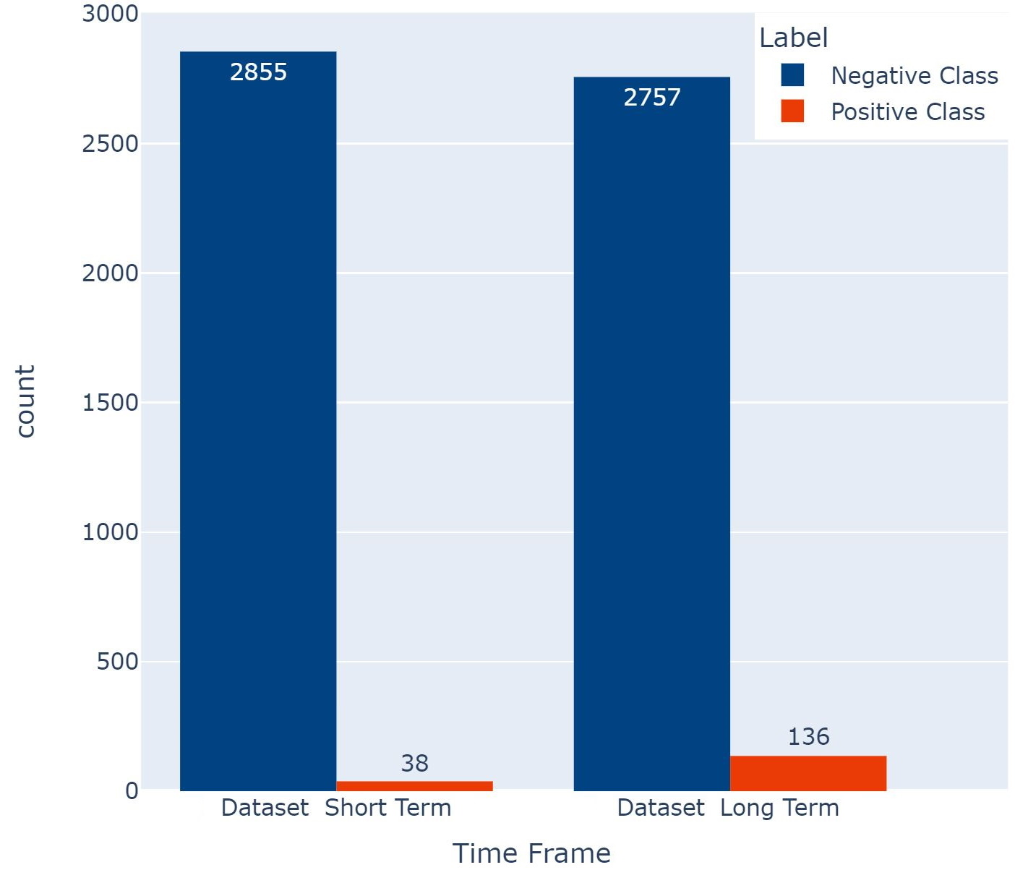
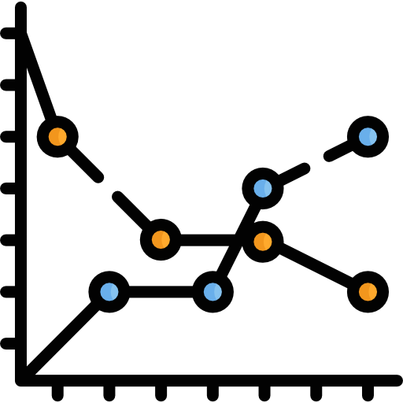
Data and its challenges Electronic Health Records from TBase
Multimodal Structure
Small and imbalanced Dataset
Demographic Data
Time Variant Data
Text
Age
Blood group
Date first dialysis
Basic kidney disease
…
Creatinine
Protein
Leukocytes
Medications
…
Clinical Texts
Microbiology exam
Pathology exam
X-Ray exam
Ultrasound exam
Notes:
TBase a EHR for Kidney Transplant recipients
Time Variant -> T-LSTM
2893 patients
Cohort criteria:
No other organ transplant
18+
Transplantation 2000 or later
Happened in Mitte or Virchow
Challenges with current solution
Problems with Preprocessing
Time Variant Data only aggregated
Weak performance on positive class

Slide 6
Methodology Data Centric Approach
Contributions
Added EHR from Virchow
New rigorous Label definition
Exclude people that die during prediction time frame
Adapted time frames
3-Fold Cross Validation
Improved clustering and cleaning
Prepared T-LSTM data
BERT-embeddings
Label definition change
Notes:
Text -> Islam and Rashik pretrained Bert model -> Text to Vector representation

Slide 7
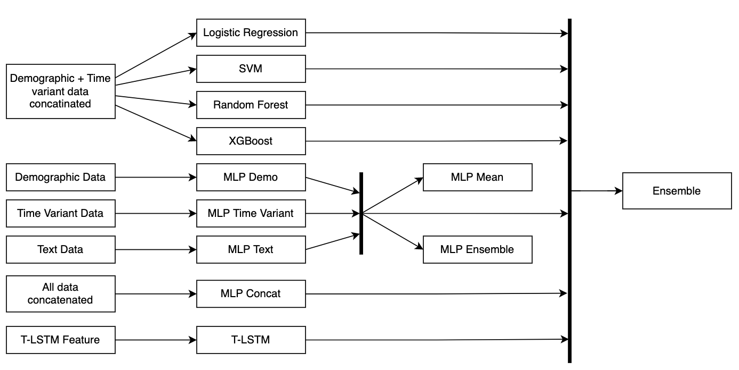
Methodology Model Centric Approach
Machine Learning Models and Late Fusion Approach
Contributions
Evaluation Metric study
New machine learning models
Early Stopping
Hyperparameter optimization
Late fusion approach
Notes:
Concatenaed -> early fusion
Mean = MLP single baselines probabilities summed up and divided by 3
Ensemble uses SVM model to learn from other probabilities

Slide 8
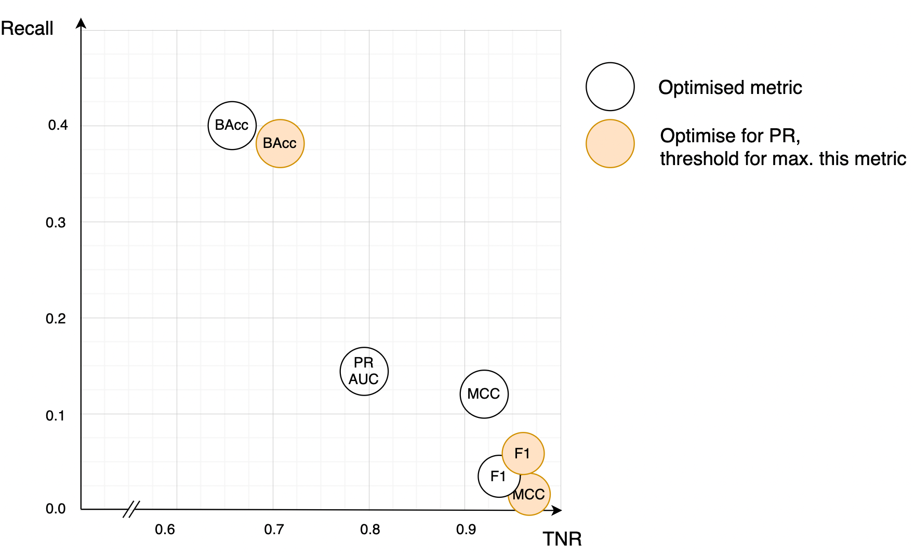
Evaluation Evaluation Metric
Maximizing different Metrics with MLP Demographic Model
BAcc achieves best Recall
Others better TNR
Choose BAcc as target metric
Notes:
T-LSTM

Slide 9
Evaluation: Long Term Prediction
MLP Baselines
All Model Baselines
Notes:
Text best single data baseline
Concatenated
T-LSTM -> 2nd highest importance in the Ensemble model
Short Term Ensemble Bacc 0.63 and Random Forest 0.75

Slide 10
Discussion Problems with late fusion
Overfitting problem
Importance correlates with overfitting
Ensemble has a bad generalization estimation

Slide 11
Conclusion
✔
Hypothesis 1: Data centric approaches improve all baselines
Hypothesis 2: Model Centric approaches improve all baselines
Hypothesis 3: Including time-dimension creates a better baseline
Hypothesis 4: Redefining the target metric improves results from a medical perspective
✔
(✔)
✔
Notes:
T-LSTM 2nd highest importance for long term stacked ensemble
Fullfillment -> Thesis Success -> Think about practical use like implementation into Tbase
Personal success:
Media Informatics -> Learned a lot Data Science knowledge -> Got me quite nice Job
Therefore Thanks for the opportunity and support to you

Slide 12
Evaluation: Short Term Prediction
MLP Baselines
All Model Baselines
Notes:
T-LSTM

Slide 13
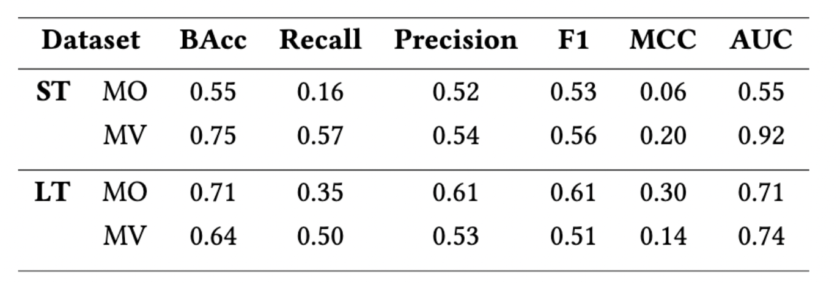
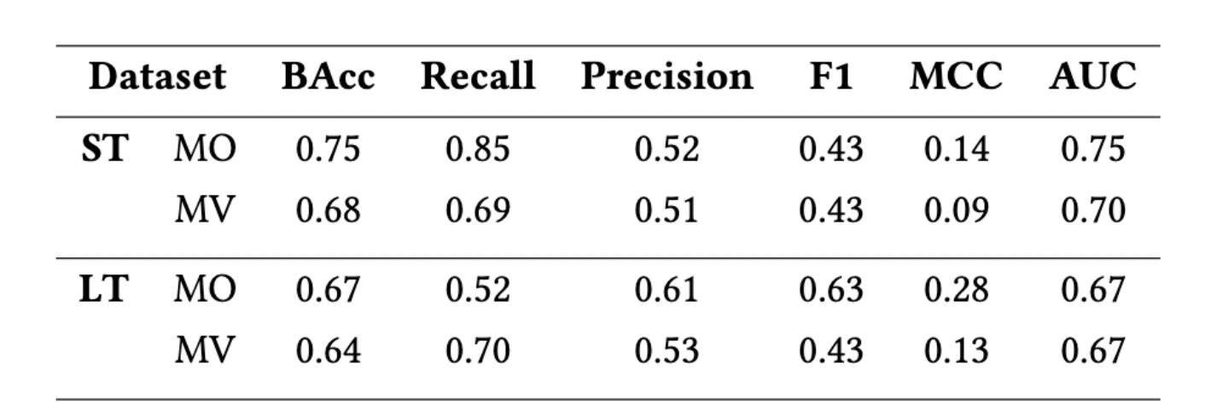
Evaluation: Data Centric Approach
Random Forrest
MLP Text

Slide 14
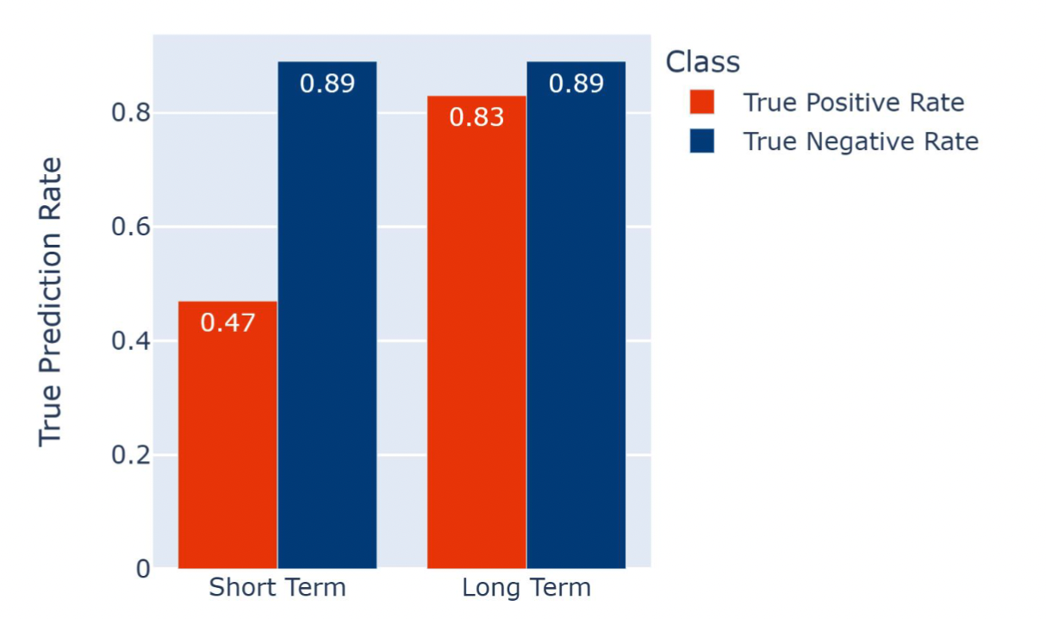
Evaluation: Long Term Prediction
Notes:
T-LSTM

Slide 15
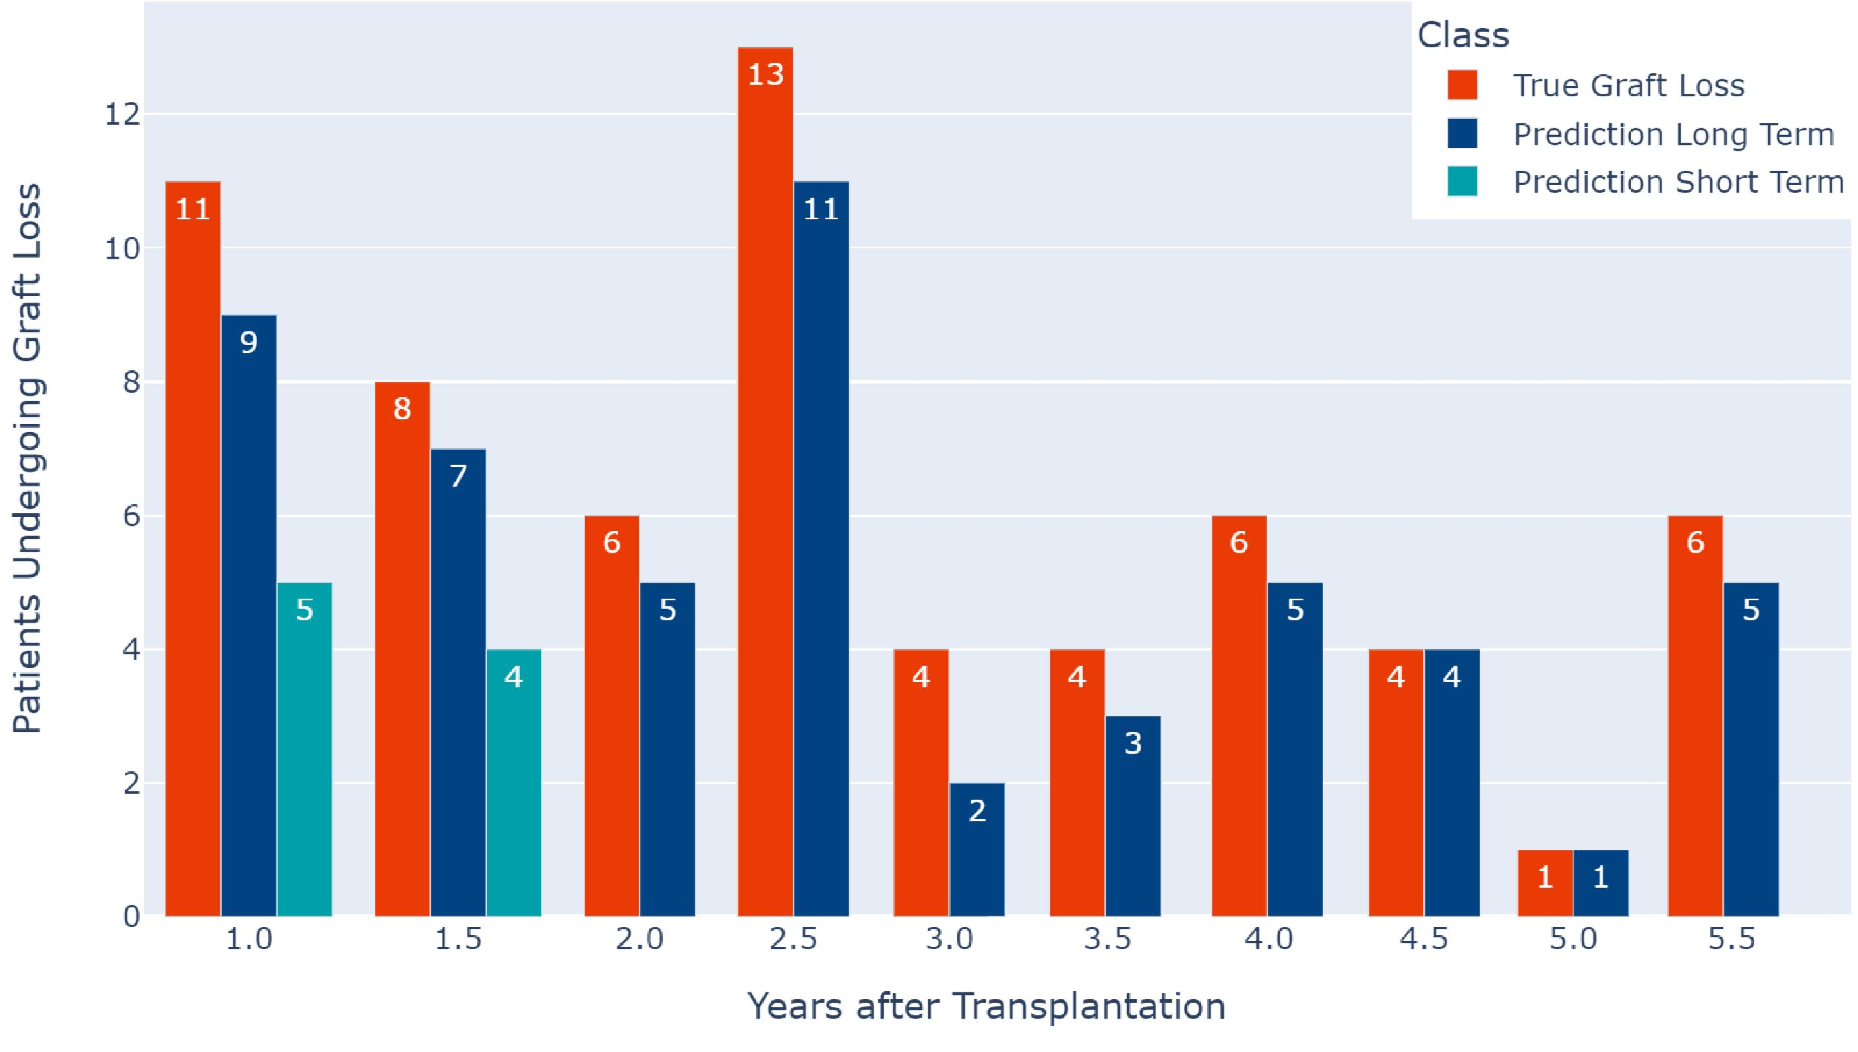
True Labels vs Ensemble Predictions per 1/2 Year

Slide 16
Random Forest Feature Importances

Slide 17
Stacked Ensemble Importances

